Slide 1
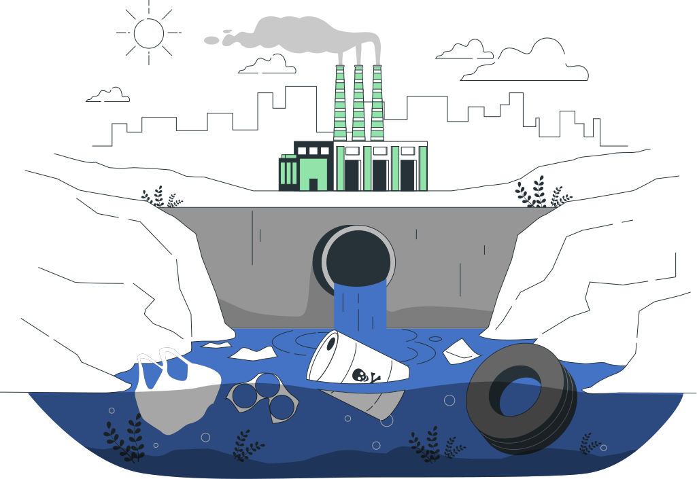

Developing Real Time Solutions to detect and neutralize river pollutants
Team Name: SEVA
Team Members:
Preethi Narasimhan
Prerana Meda Krishna
Ranjan Devi
1

Slide 2
Problem Statement
How might we develop effective systems to detect and neutralize harmful pollutants in real-time, promoting the restoration of river ecosystems?
2

Slide 3
Introduction
Our solution involves a cutting-edge wastewater treatment system that utilizes real-time monitoring with IoT sensors and genetically engineered microorganisms (GEMs) to detect and neutralize pollutants. The system ensures treated water meets purity standards before being released back into rivers or reused domestically.
3

Slide 4




Wastewater input
Real-Time Pollutant Detection using sensors
Targeted GEM Treatment (Sequential Pollutant Removal)
Fluorescence Monitoring (Check water purity levels)
Purified water
4

Slide 5
Detailed Solution
Real-Time Pollutant Detection:
Wastewater is passed through a monitoring system equipped with IoT-enabled sensors. These sensors analyze key parameters such as Chemical Oxygen Demand (COD), Biological Oxygen Demand (BOD), turbidity, and concentrations of specific pollutants like heavy metals, nitrogen, and phosphates.
The data collected is processed in real time to identify pollutant levels, ensuring timely detection of harmful contaminants.
5

Slide 6
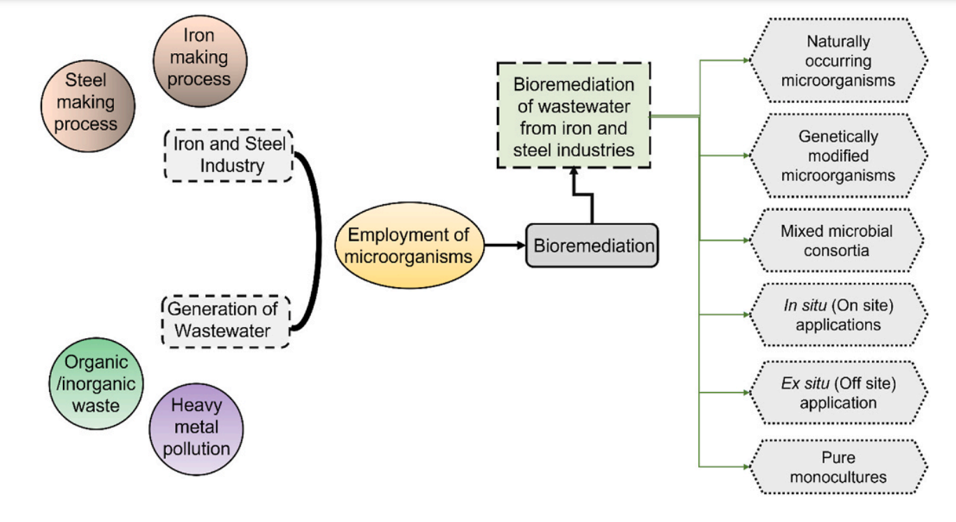
Bioremediation of pollutants using different processes
6

Slide 7
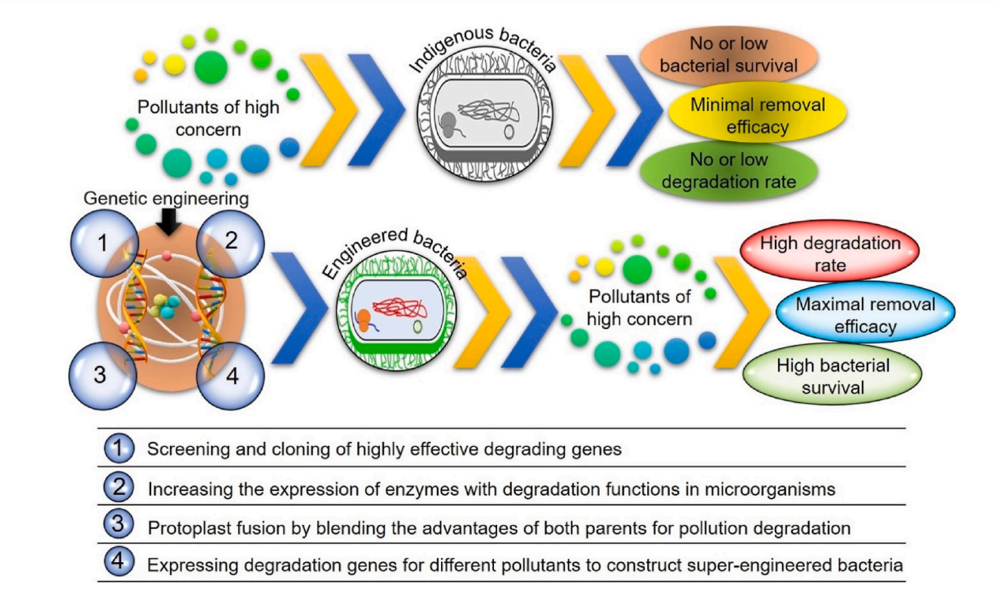
Induced Degradation process using GEMs
7

Slide 8


DETAILED SOLUTION
This system uses Genetically Engineered Microorganisms (GEMs) for:
Real-time detection of pollutants.
Targeted degradation of harmful substances.
System Chamber
DETECTION PARTITION
DEGRADATION PARTITION
Contains immobilized GEMs in calcium alginate pods for continuous pollutant detection via fluorescence.
Houses degrading GEMs that break down pollutants, with micropermeable filters separating the two partitions to prevent GEM interaction.
8

Slide 9
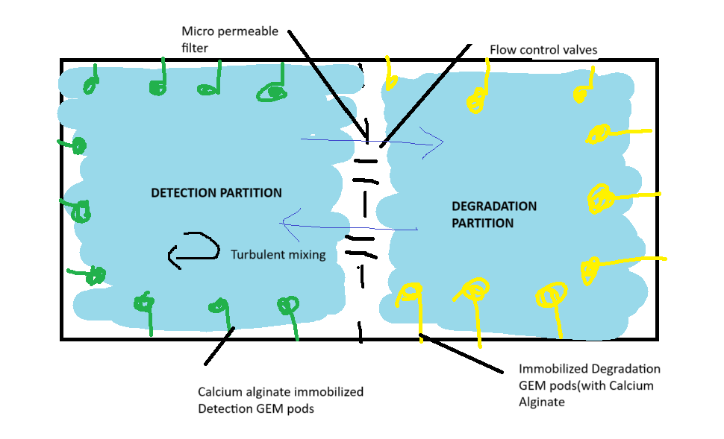
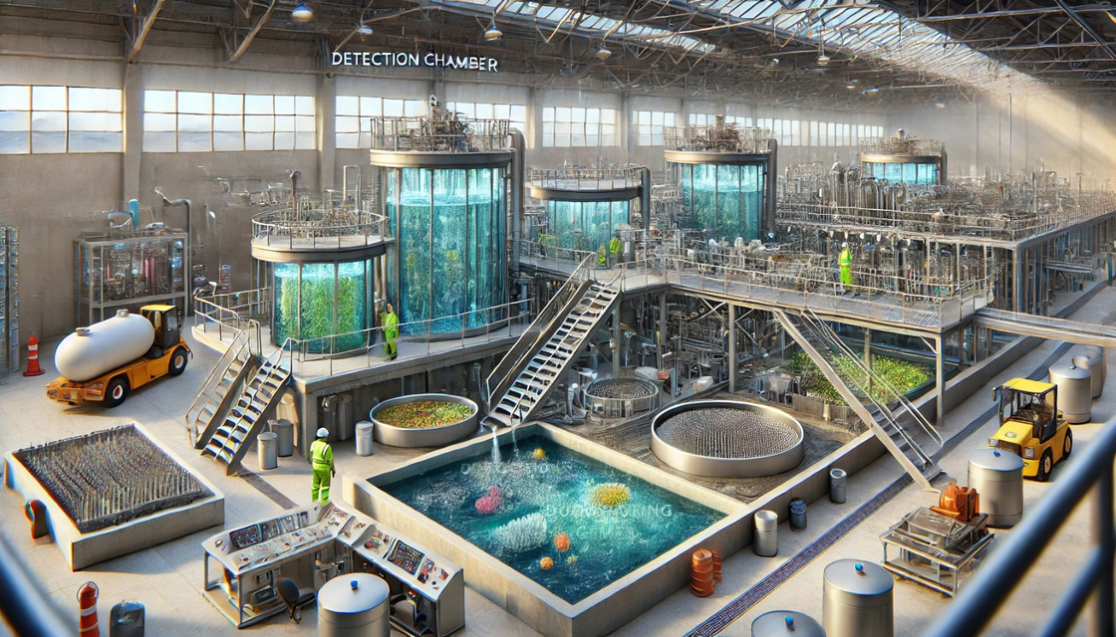
Diagramatic Representations of solution
9

Slide 10

Step 1 : Pollutant Detection in the Detection Partition
Water flows through the detection partition, where calcium alginate-immobilized GEMs are located along the chamber walls.
Each GEM strain reacts specifically to pollutants like heavy metals, pesticides, or hydrocarbons, emitting fluorescence.
The fluorescence intensity is directly correlated with the pollutant concentration in the water.
Continuous Monitoring: Fluorescence sensors continuously measure the intensity and color of the emitted light, providing real-time data on pollutant levels.
10

Slide 11
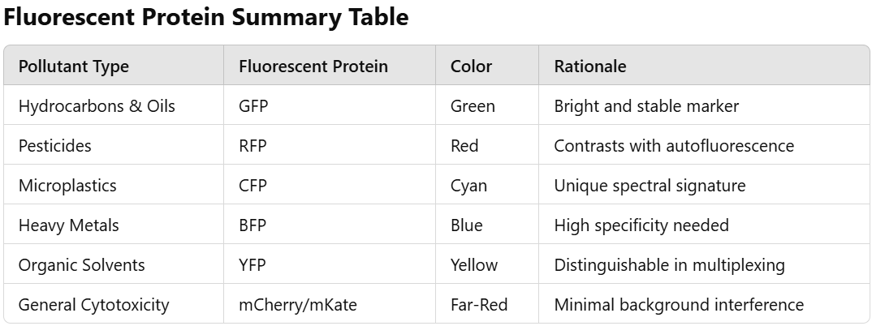
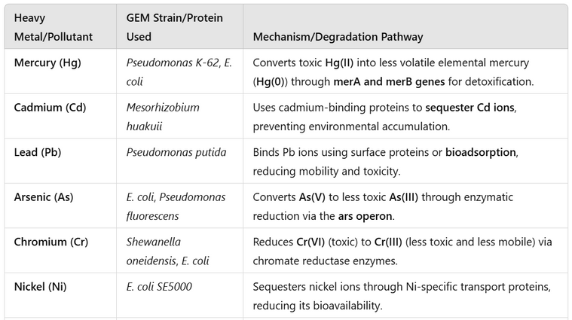
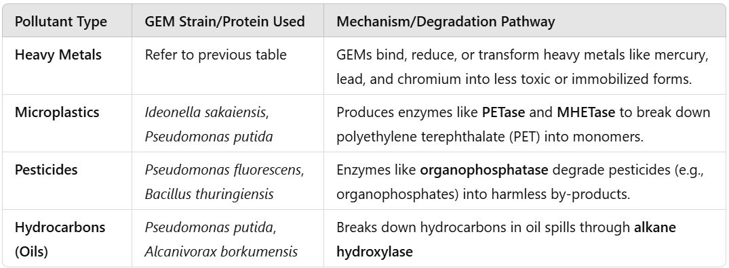
11

Slide 12

Step 2 : Data Analysis and Threshold Comparison
Data Analysis: Fluorescence intensity is processed in real-time.
Threshold Comparison: The system compares the data to predefined pollutant thresholds:
If pollutants are below threshold, water is directed to the effluent monitoring chamber.
If pollutants exceed threshold, water moves to the degradation partition.
12

Slide 13
Step 2 : Data Analysis and Threshold Comparison
Data Analysis: Fluorescence intensity is processed in real-time.
Threshold Comparison: The system compares the data to predefined pollutant thresholds:
If pollutants are below threshold, water is directed to the effluent monitoring chamber.
If pollutants exceed threshold, water moves to the degradation partition.
13

Slide 14

Step 3 : Pollutant Degradation in Degradation Partition
WATER ENTERS DEGRADATION CHAMBER
Polluted water moves from Detection Partition to Degradation Partition.
GEM INTRODUCTION IN BATCHES
Degrading GEMs are added to break down pollutants.
MICROPERMEABLE FILTER
Separates Detection and Degradation partitions, allowing only water and pollutants through.
Water Exits for Final Treatment
Cleaned water moves to the next stage for quality assurance.
Pollutant Breakdown
Degrading GEMs metabolize pollutants, reducing their concentration.
Flow Control
Flow valves regulate water movement for optimal exposure to GEMs.
14

Slide 15


Step 4 : Effluent Monitoring and Final Quality Check
Water is directed to the effluent monitoring chamber, where quality sensors(pH, turbidity, and chemical sensors) check the final water quality.
If the water meets quality standards
It is redirected to degradation partition in chamber
it is released into the environment or stored.
Effluent Quality Monitoring
Effluent Monitoring:
,
If pollutants remain, it is redirected for further treatment.
15

Slide 16
Alignment with Sustainable Development Goals
SDG 6: Clean Water and Sanitation – Promotes access to safe water by treating polluted sources.
SDG 12: Responsible Consumption and Production – Encourages water reuse and minimizes waste.
“By addressing these goals, we’re not just solving a problem but contributing to a global mission of sustainability and environmental restoration.”
16

Slide 17

Unique Value Proposition
REAL TIME
DETECTION
INTELLIGENT
FLOW
OPTIMIZATION
TARGETED
DEGRADATION
Turbulent flow management ensures even water distribution across detection and degradation zones.
Prevents stagnation and optimizes contact between water, detection pods, and degrading GEMs, leading to consistent treatment outcomes.
Pumps and diffusers work together to create a dynamic flow, enhancing system performance.
Immediate identification of pollutants through fluorescent signals generated by Genetically Engineered Microbes (GEMs).
These signals provide precise data on pollutant type and concentration, allowing for real-time adjustments to treatment protocols.
Eliminates the need for external laboratory testing, reducing response times and operational delays.
Partitioned zones separate detection and degradation processes, ensuring precise treatment without interference.
Specialized GEM strains are introduced for pollutant-specific breakdown, maximizing degradation efficiency while minimizing resource wastage.
The controlled environment allows for focused action on pollutants like hydrocarbons, heavy metals, and pesticides.
17

Slide 18





Long-Term Impact and Sustainability
ENERGY AND RESOURCE EFFICIENCY
Biological processes reduce energy use.
Less reliance on chemical treatments.
SCALABLE GLOBAL IMPACT
Adaptable for various geographies.
Scalable for both small and large-scale applications.
ENVIRONMENTAL
RESTORATION
Cleaner habitats for aquatic life.
Reduction in hazardous contaminants.
SUSTAINABLE WATER MANAGEMENT
Closed-loop water recycling.
Reduced dependence on freshwater extraction.
18

Slide 19
Feasibility and Practicality
Technological Feasibility:
GEMs for pollutant detection & degradation.
Calcium Alginate Pods for stability.
Micropermeable Filters for separation.
2. Economic Feasibility:
Lower operational costs (energy & chemicals).
Modular & scalable for various applications.
3. Environmental Feasibility:
Reduced chemical use and sustainable water management.
Adaptable for global implementation.
4. Operational Practicality:
Easy integration with existing systems.
Automated & user-friendly design.
5. Social & Regulatory Feasibility:
Improves public health.
Regulation compliance and eco-friendly impact.
19

Slide 20
TECHNOLOGIES AND
TOOLS
Step 1: Partitioned Detection and Degradation Chamber Setup
Calcium Alginate Pods: For immobilizing GEMs for pollutant detection.
Micropermeable Filters: To separate the detection and degradation zones.
Pumps and Diffusers: For even water distribution and flow optimization.
Step 2: Pollutant Detection Using Immobilized GEMs
Fluorescent Detection System: For detecting light emission from GEMs exposed to pollutants.
Genetically Engineered Microbes (GEMs): Specific strains programmed for pollutant detection via fluorescence.
Step 3: Pollutant Degradation Using GEMs
Genetically Engineered Microbes (GEMs): For pollutant breakdown (e.g., pesticides, heavy metals).
Micropermeable Filter: Ensures separation between detection and degradation zones.
20

Slide 21
TECHNOLOGIES AND
TOOLS
.Step 4: Real-Time Monitoring and Data Collection
Fluorescence Sensors: For continuous monitoring of pollutant levels during detection.
Data Analysis System: Collects and analyzes fluorescence data for real-time pollutant profiles.
Step 5: Final Water Quality Assurance and Effluent Monitoring
Effluent Quality Monitoring: For final analysis to ensure all pollutants have been degraded.
Post-Treatment Sensors: To verify the effectiveness of the degradation process.
Step 6: Water Discharge or Recycling
Discharge System: For releasing purified water back into the environment.
Water Recycling System: For reintroducing treated water into the cycle.
21

Slide 22

REFERENCES
Genetically engineered microorganisms for environmental remediation, Author: panelHamza Rafeeq, Nadia Afsheen, Sadia Rafique, Arooj Arshad, Maham Intisar, Asim Hussain, Muhammad Bilal d, Hafiz M.N. Iqbal. https://doi.org/10.1016/j.chemosphere.2022.136751
Yaroshenko, I.; Kirsanov, D.; Marjanovic, M.; Lieberzeit, P.A.; Korostynska, O.; Mason, A.; Frau, I.; Legin, A. Real-Time Water Quality Monitoring with Chemical Sensors. Sensors 2020, 20, 3432. https://doi.org/10.3390/s20123432
Advances in quantifying microbial contamination in potable water: Potential of fluorescence-based sensor technology. Hannah Gunter, Chris Bradley, David M. Hannah, Semira Manaseki-Holland, Rob Stevens, Kieran Khamis. https://doi.org/10.1002/wat2.1622
Nies, D. H. (1999). "Microbial heavy-metal resistance." Applied Microbiology and Biotechnology. DOI: 10.1007/s002530051386.
22

Slide 23
REFERENCES
Genetically Engineered Microorganisms for Bioremediation https://www.researchgate.net/publication/348509494_Recent_Advances_in_the_Application_of_Genetically_Engineered_Microorganisms_for_Microbial_Rejuvenation_of_Contaminated_Environment
Bioremediation – the recent drift towards a sustainable environment. https://pubs.rsc.org/en/content/articlehtml/2024/va/d3va00358b
23

